Slide 1
From Demo
to Dependable
Journey of taking AI from experiment to enterprise scale
Bhuvaneshwari Rajasekar | Sr AI Engineering Manager | Architect

Slide 2
02
BEFORE ANY AI PROJECT
What is the first question
you ask before starting
any project?
Day 0
Day 0-90
Launch
Live
Steady state

Slide 3
18
THE WHY
அழிவதூஉம் ஆவதூஉம் ஆகி வழிபயக்கும்
ஊதியமும் சூழ்ந்து செயல்.
— குறள் 461
“Act after taking into account the cost, the benefit and the result”
You can build the right thing well and still solve the wrong problem.
Day 0
Day 0-90
Launch
Live
Steady state

Slide 4
03
THE ONLY QUESTION THAT MATTERS
“What is the solid customer problem?”
01
02
03
What?
Who?
What does “good enough” mean?
The problem stated in one sentence.
A real customer. Not a persona.
To them. Not to us.
A POC is how you start without being overwhelmed.
Day 0
Day 0-90
Launch
Live
Steady state

Slide 5
04
THE POC
Start wide — research, ideate, multiple approaches
Research
→
Ideate
→
Multiple approaches
→
Prototype
There is never one way to solve the problem.
That’s the good news — and the trap.
Day 0
Day 0-90
Launch
Live
Steady state

Slide 6
05
THE TRAP
Analysis paralysis
STUCK
THE WAY OUT
Research mode forever.
Time-box it.
Every approach has a defender. Every week adds one more option worth trying.
A deadline forces the question nobody wants to ask — what are we measuring?
Day 0
Day 0-90
Launch
Live
Steady state

Slide 7
06
THE DECISION THAT MADE EVERY LATER DECISION EASY
We agreed the scoreboard before we played
1
2
3
Scale
Accuracy
Cost per unit
Does the approach hold for thousands of categories?
How effective is the output on real data?
The number that decides whether it survives.
Ranked, not weighted. When approaches disagreed, the order decided — and nobody argued.
Day 0
Day 0-90
Launch
Live
Steady state

Slide 8
07
ACT TWO — THE PROOF
Ninety days to earn a yes, or an honest no
DAY 30
DAY 60
DAY 90
Multiple approaches
Evidence
A decision
Research done. Credible options on the table.
Tested on real data samples.
Made on the agreed metrics.
A research phase without a deadline is a hobby.
Day 0
Day 0-90
Launch
Live
Steady state

Slide 9
08
POC DONE. APPROACH SELECTED.
Now prove it will still be standing in two years
Scale the knowledge. Not the demo dataset.
Validate at production volume. The winner can change.
Test for growth. Will it carry new domains, or only today’s?
The question is no longer “does it work?” It is “will it still work when everything grows?”
Day 0
Day 0-90
Launch
Live
Steady state

Slide 10
09
THE MOST IMPORTANT PART OF ANY AI PROJECT
Trustworthy labelled data
Garbage in, garbage out. No model recovers from bad ground truth.
Experts disagree. The same input can have more than one defensible answer.
Mark the ambiguity. And keep it out of your accuracy number.
Day 0
Day 0-90
Launch
Live
Steady state

Slide 11
10
THE ROLE THAT DECIDES THE OUTCOME
Domain experts are not reviewers. They are the source.
Evals
Domain expertise
Real feedback / UAT
They define what “correct” actually means.
Solving the real problem, not the visible one.
The only validation that counts.
With real data, validated at scale, the basement is strong enough to build on.
Day 0
Day 0-90
Launch
Live
Steady state

Slide 12
11
THE GAP
A demo and a product are not the same artefact
A POC
A PRODUCT
has to work once.
has to work every time, at any hour, for anyone who wants it — including people who didn’t build it and don’t care how it works.
Day 0
Day 0-90
Launch
Live
Steady state

Slide 13
12
DON’T FORGET THE BASEMENT
“Production-ready” — everything traditional, plus what AI adds
Existing software standards and NFRs still fully apply. The basics did not stop mattering.
Versioned prompts
Observable
Feedback loop
A prompt change is a behaviour change.
Quality, latency and cost. Not just uptime.
Built in, not bolted on.
Model limits
Regression & drift
Security & guardrails
TPM/RPM ceilings → perf testing, honest expectations.
A running process, not a task.
Against misuse of the model itself.
Day 0
Day 0-90
Launch
Live
Steady state

Slide 14
18
THE CUSTOMER USAGE
நன்றாற்ற லுள்ளுந் தவறுண்டு அவரவர்
பண்பறிந் தாற்றாக் கடை.
— குறள் 469
“Even the best intentions can go wrong if they don’t fit the recipient’s needs.”
Just categorizing alone is not usable.
Day 0
Day 0-90
Launch
Live
Steady state

Slide 15
13
THE CUSTOMER HAS TO TRUST THE OUTPUT
Confidence without explanation is just a number
Show confidence — and the reasoning behind it.
Explain without exposing. Enough “why” to judge. Not enough to copy the logic.
Know when to route to a human. And show the user that it happened.
Trust is what turns an accurate system into an adopted one.
Day 0
Day 0-90
Launch
Live
Steady state

Slide 16
14
THE CROSSING
Ship before you’re comfortable.
You can’t catch everything.
Basic guardrails, good-enough quality. Then get it to real users.
You cannot perfect this in a lab. The remaining unknowns only exist in production — in the hands of someone who doesn’t know how it works and doesn’t care.
Day 0
Day 0-90
Launch
Live
Steady state

Slide 17
15
ACT FOUR — THE LOOP
Day one live is the start of the project
Everything before this was preparation. Everything after it is the actual work.
SHIP
LEARN
SHIP AGAIN
The line you’ve been following becomes a circle.
Day 0
Day 0-90
Launch
Live
Steady state

Slide 18
16
THE ASSET MOST TEAMS THROW AWAY
Every correction is free training signal
User corrects
→
Captured
→
Structured
→
Routed back
Engineering vetted it, consulted experts, retuned prompts, improved the knowledge.
Most teams log the prediction and discard the correction.
The correction was the valuable half.
Day 0
Day 0-90
Launch
Live
Steady state

Slide 19
17
WHAT SUCCESS BROKE
The loop that worked stopped scaling
Feedback became overwhelming. Every new customer and new domain added more.
Engineering sat in the middle of every change. A queue formed.
Experts couldn’t tune directly. They know the domain — not prompt structure or AI system internals.
Day 0
Day 0-90
Launch
Live
Steady state

Slide 20
18
THE ENGINEERING BOTTLENECK
இதனை இதனால் இவன்முடிக்கும் என்றாய்ந்து
அதனை அவன்கண் விடல்.
— குறள் 517
“Know who can do the work, then let that person own it.”
Engineering builds the tuning system. Domain experts tune the knowledge.
Day 0
Day 0-90
Launch
Live
Steady state

Slide 21
19
THE STRUCTURAL FIX
Build the system that lets experts tune the knowledge
ENGINEERING
DOMAIN EXPERTS
THE RESULT
Builds the agentic tuning system.
Improve the knowledge through it.
Days become minutes.
Both sides do what they do best.
Day 0
Day 0-90
Launch
Live
Steady state

Slide 22
20
MAKING IT REPEATABLE
AI workflows that keep the loop honest
Regression
Drift detection
Continuous feedback
Did this change break yesterday’s good answers?
Did the world move underneath us?
Always on. Not campaign-based.
Day 0
Day 0-90
Launch
Live
Steady state

Slide 23
21
OPERATIONS
Operational readiness
Runbooks. Written before they’re needed.
An alert nobody owns is just a log line with anxiety.
Alerts and monitors. On quality and cost — not just CPU.
On-call support. A named owner, not a shared inbox.
Day 0
Day 0-90
Launch
Live
Steady state

Slide 24
22
WHAT WE ASSUMED — AND WHAT WE FOUND
Coding was never the biggest bottleneck
WE ASSUMED
WE FOUND
AI makes us faster because it writes code.
Requirement clarity is the constraint.
We thought generation speed was the win.
Unclear requirements — not coding capacity — became the largest delivery constraint.
Decisions weren’t frozen fast enough to keep up with build speed — and requirements were still being written for the old cost of building.
Day 0
Day 0-90
Launch
Live
Steady state

Slide 25
23
AI CHANGED THE ECONOMICS
The cost of waiting is now higher than the cost of building
OLD WORLD
AI WORLD
Building was expensive.
Waiting felt free.
Building is cheap.
Delay is the expensive part.
Engineering pulled into the requirements phase. Weekly decisions became daily.
Day 0
Day 0-90
Launch
Live
Steady state

Slide 26
24
THE PART THAT ISN’T TECHNICAL
The operating model is part of the architecture
Weekly cadence
→
Daily
HAT → HA³T
Handoffs
→
Co-ownership
Accountable
Requirements thrown over
→
Engineering in the room
AI-First
Action-Oriented
You cannot ship a fast product through a slow organisation.
“Code gets written faster” → “Change gets shipped faster.”
Day 0
Day 0-90
Launch
Live
Steady state

Slide 27
25
ACT FIVE — THE MACHINE
Improvement becomes a schedule, not a heroic act
Design in Figma
→
Prototype in a day
→
Real user feedback
→
Monthly release
Prototypes are cheap now. Which means opinions should be cheap too — replace the debate with a working thing.
Day 0
Day 0-90
Launch
Live
Steady state

Slide 28
26
MOVING FAST WITHOUT BREAKING
Boring things are the real game changers
Automation testing
Deployment readiness
The only way monthly is survivable.
Every release. Not just the big ones.
Faster debugging and fixing
Prepare for the bad day
Datadog agent, Claude ops.
What happens when the system breaks?
Nobody applauds this work. It is the reason the applause is possible.
Day 0
Day 0-90
Launch
Live
Steady state

Slide 29
18
NEVER STOP LEARNING
ஓதுவது ஒழியேல்
— ஆத்திசூடி
The goal isn't perfection. It's the system, the team that never stops learning.
Day 0
Day 0-90
Launch
Live
Steady state

Slide 30
27
THE WHOLE TALK, ON ONE SLIDE
Everything above, compressed
1
Start with the customer problem, not the AI stack.
7
Trust needs reasoning, not just a confidence score.
2
Time-box research. Agree the scoreboard first.
8
Ship before you’re comfortable.
3
Validate at scale — the winner changes.
9
The correction is worth more than the prediction.
4
Trustworthy data beats model choice. Every time.
10
Experts tune the knowledge; engineering builds the system.
5
Domain experts are the source, not the reviewers.
11
Clarity is the bottleneck once AI writes the code.
6
Production means the old NFRs plus the AI ones.
12
Boring operations are what let you move fast.
Day 0
Day 0-90
Launch
Live
Steady state

Slide 31
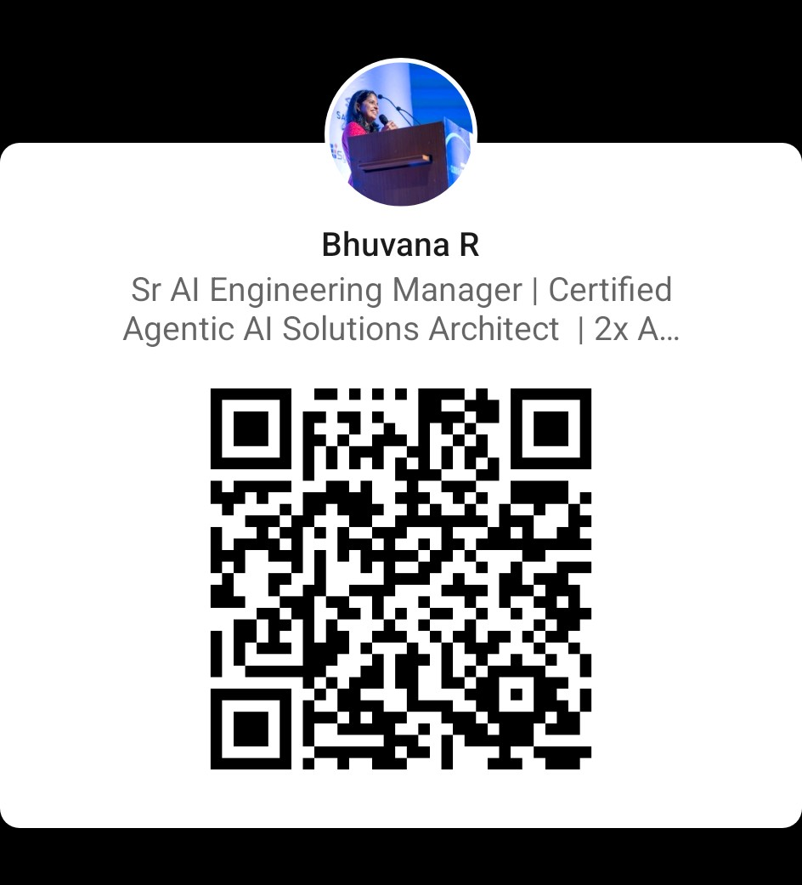
You do not build your way to a great AI product.
You ship your way there.
Thank you.

